Slide 1
Lezione 1 introduction & schematic
Stefan Cristi Zugravel 13/01/2026

Slide 2
Course Objectives
Manage hardware projects using Git version control
Design PCB schematics and layouts using KiCad
Perform basic SPICE simulations to validate critical circuits
Understand FPGA architecture and HDL design methodology
Develop, simulate, and synthesize simple VHDL modules
Use XILINX VIVADO and integrate IP cores

Slide 3
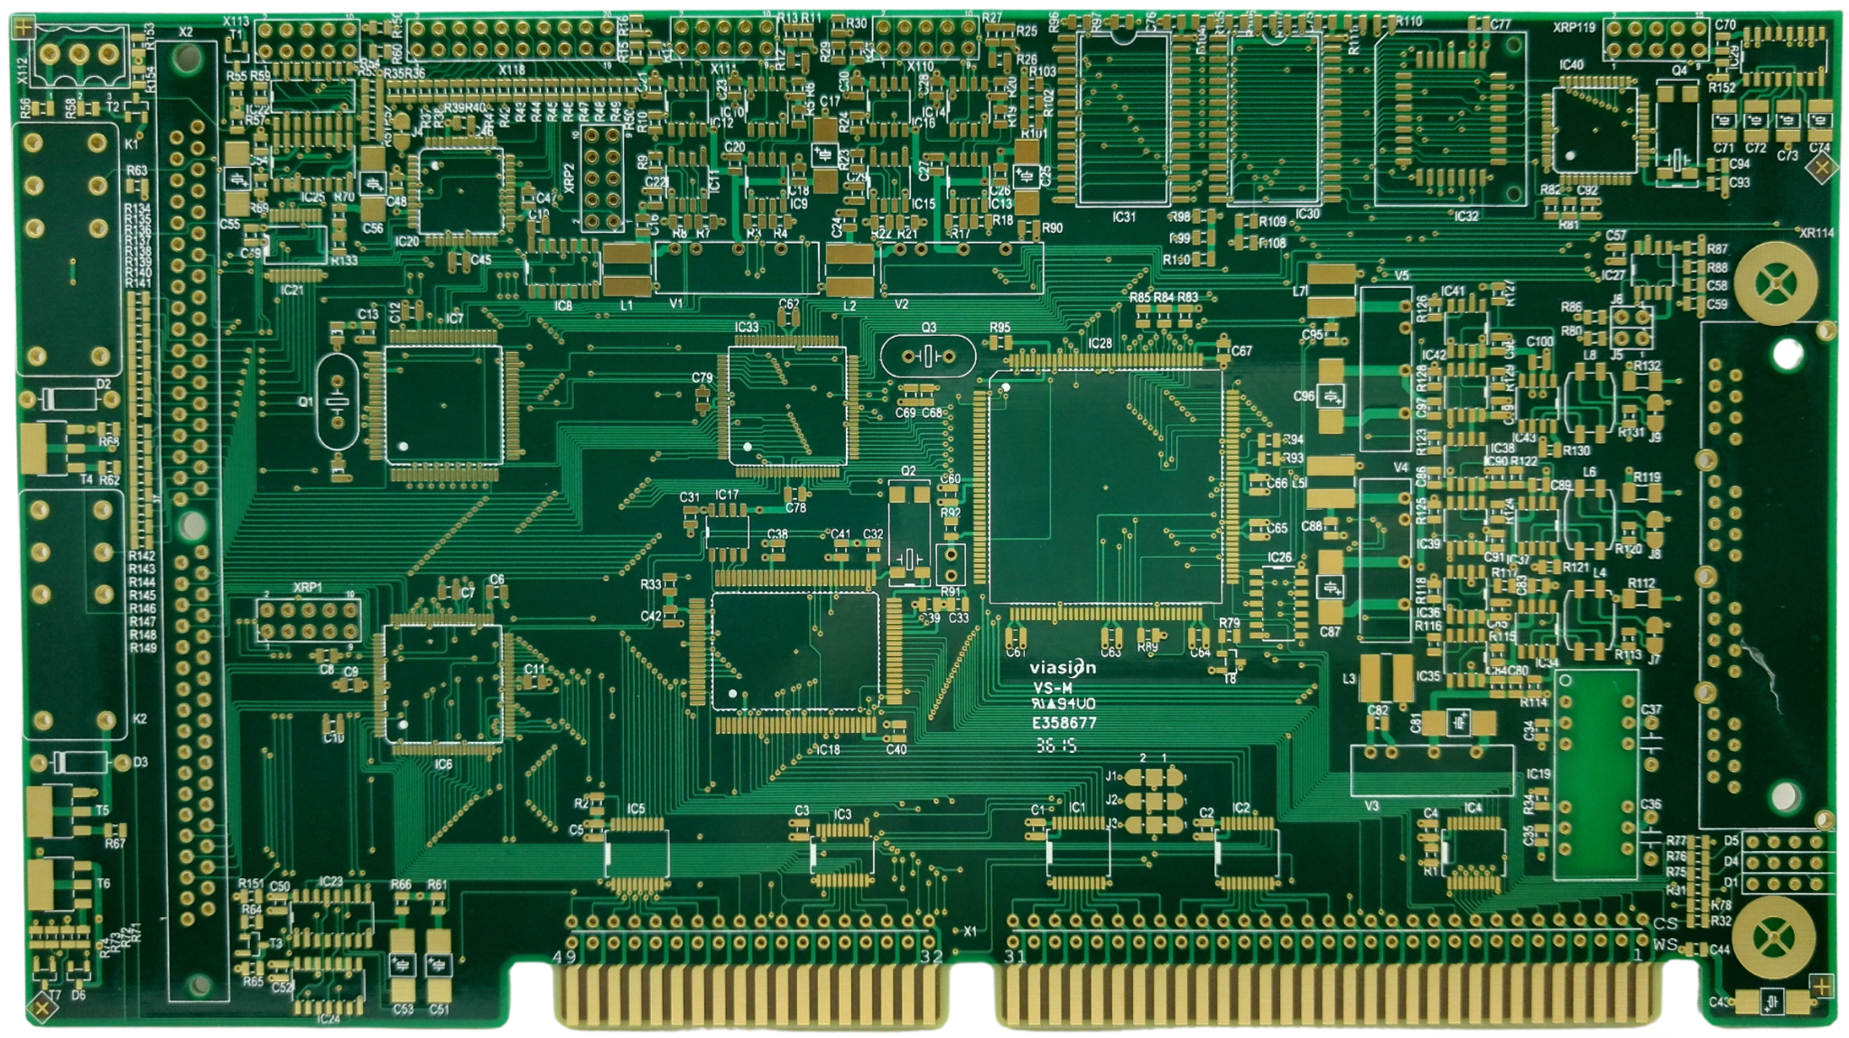
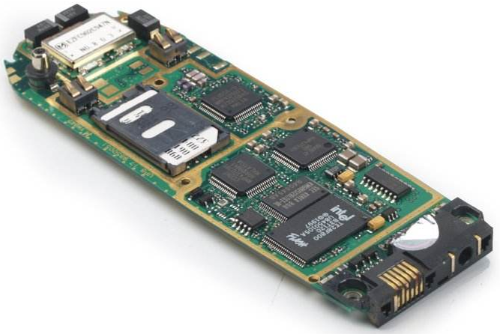
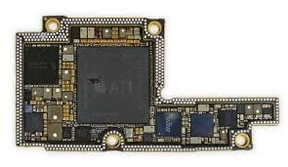
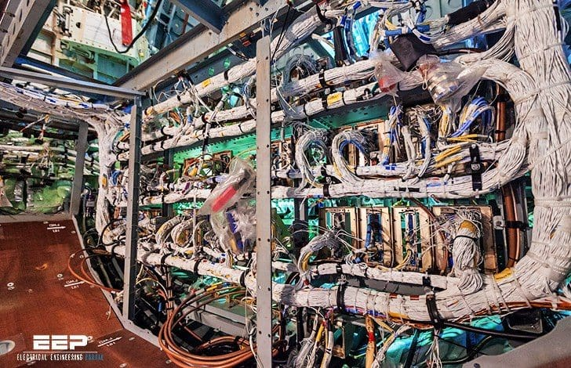
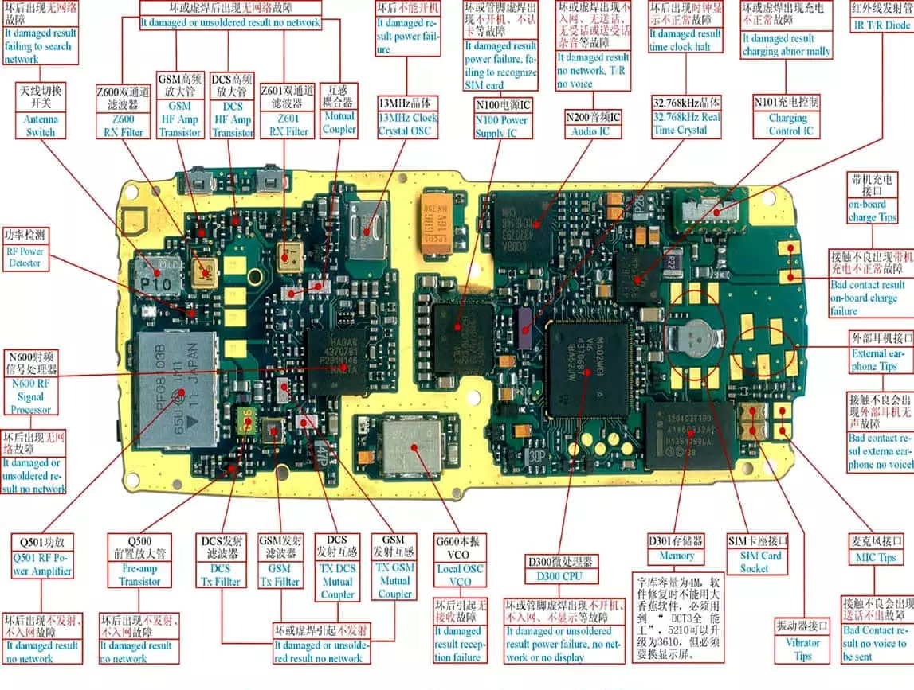
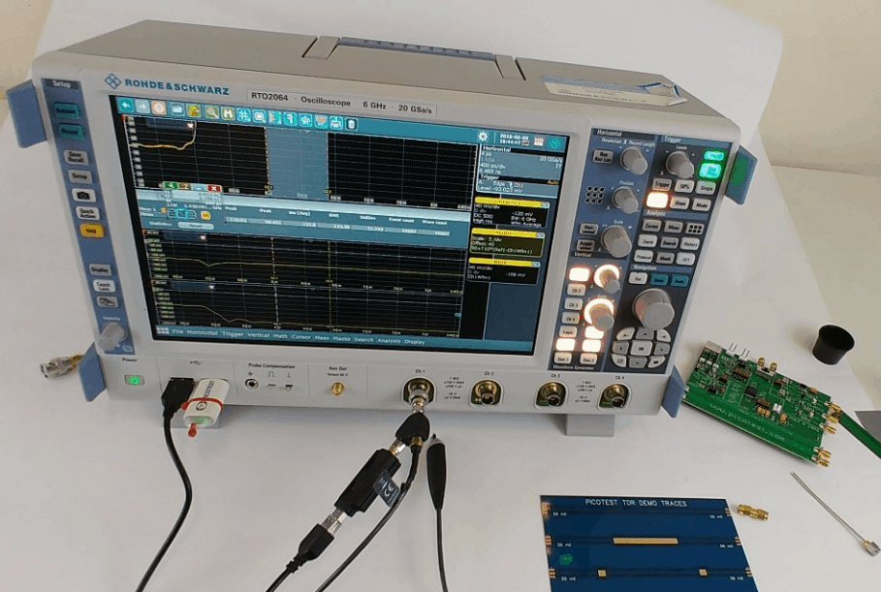
PCB, electronics
Consumer Electronics
Industrial & Automotive
Telecommunications & Networking
Medical Electronics
Aerospace, Defense, & Maritime
Lighting
Instrumentation
Ecc ….

Slide 4
Tools Used
Git (versioning)
Draw.io (block diagrams)
KiCad (Schematic & PCB)
NGspice & LTspice (simulation)
XILINX VIVADO (FPGA)

Slide 5
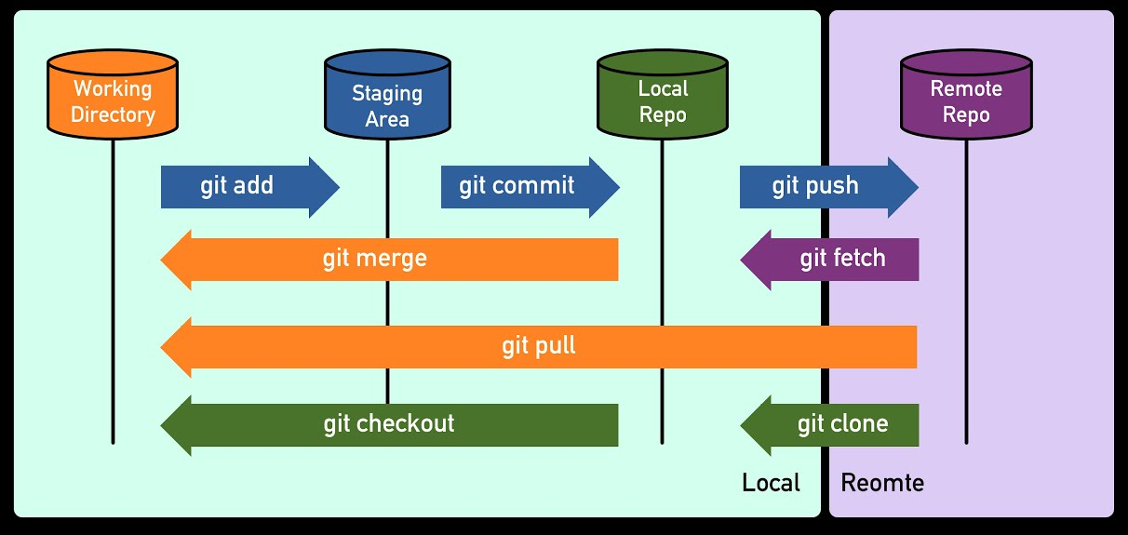
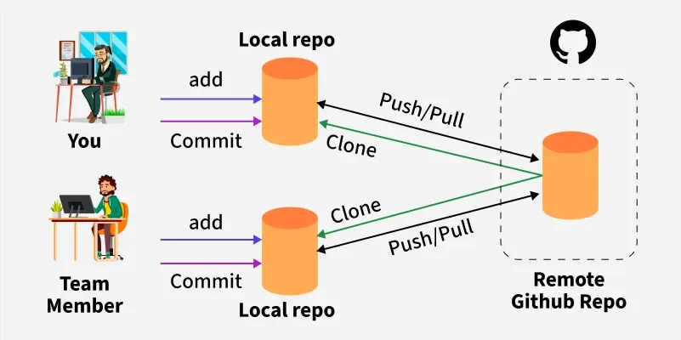
Git

Slide 6
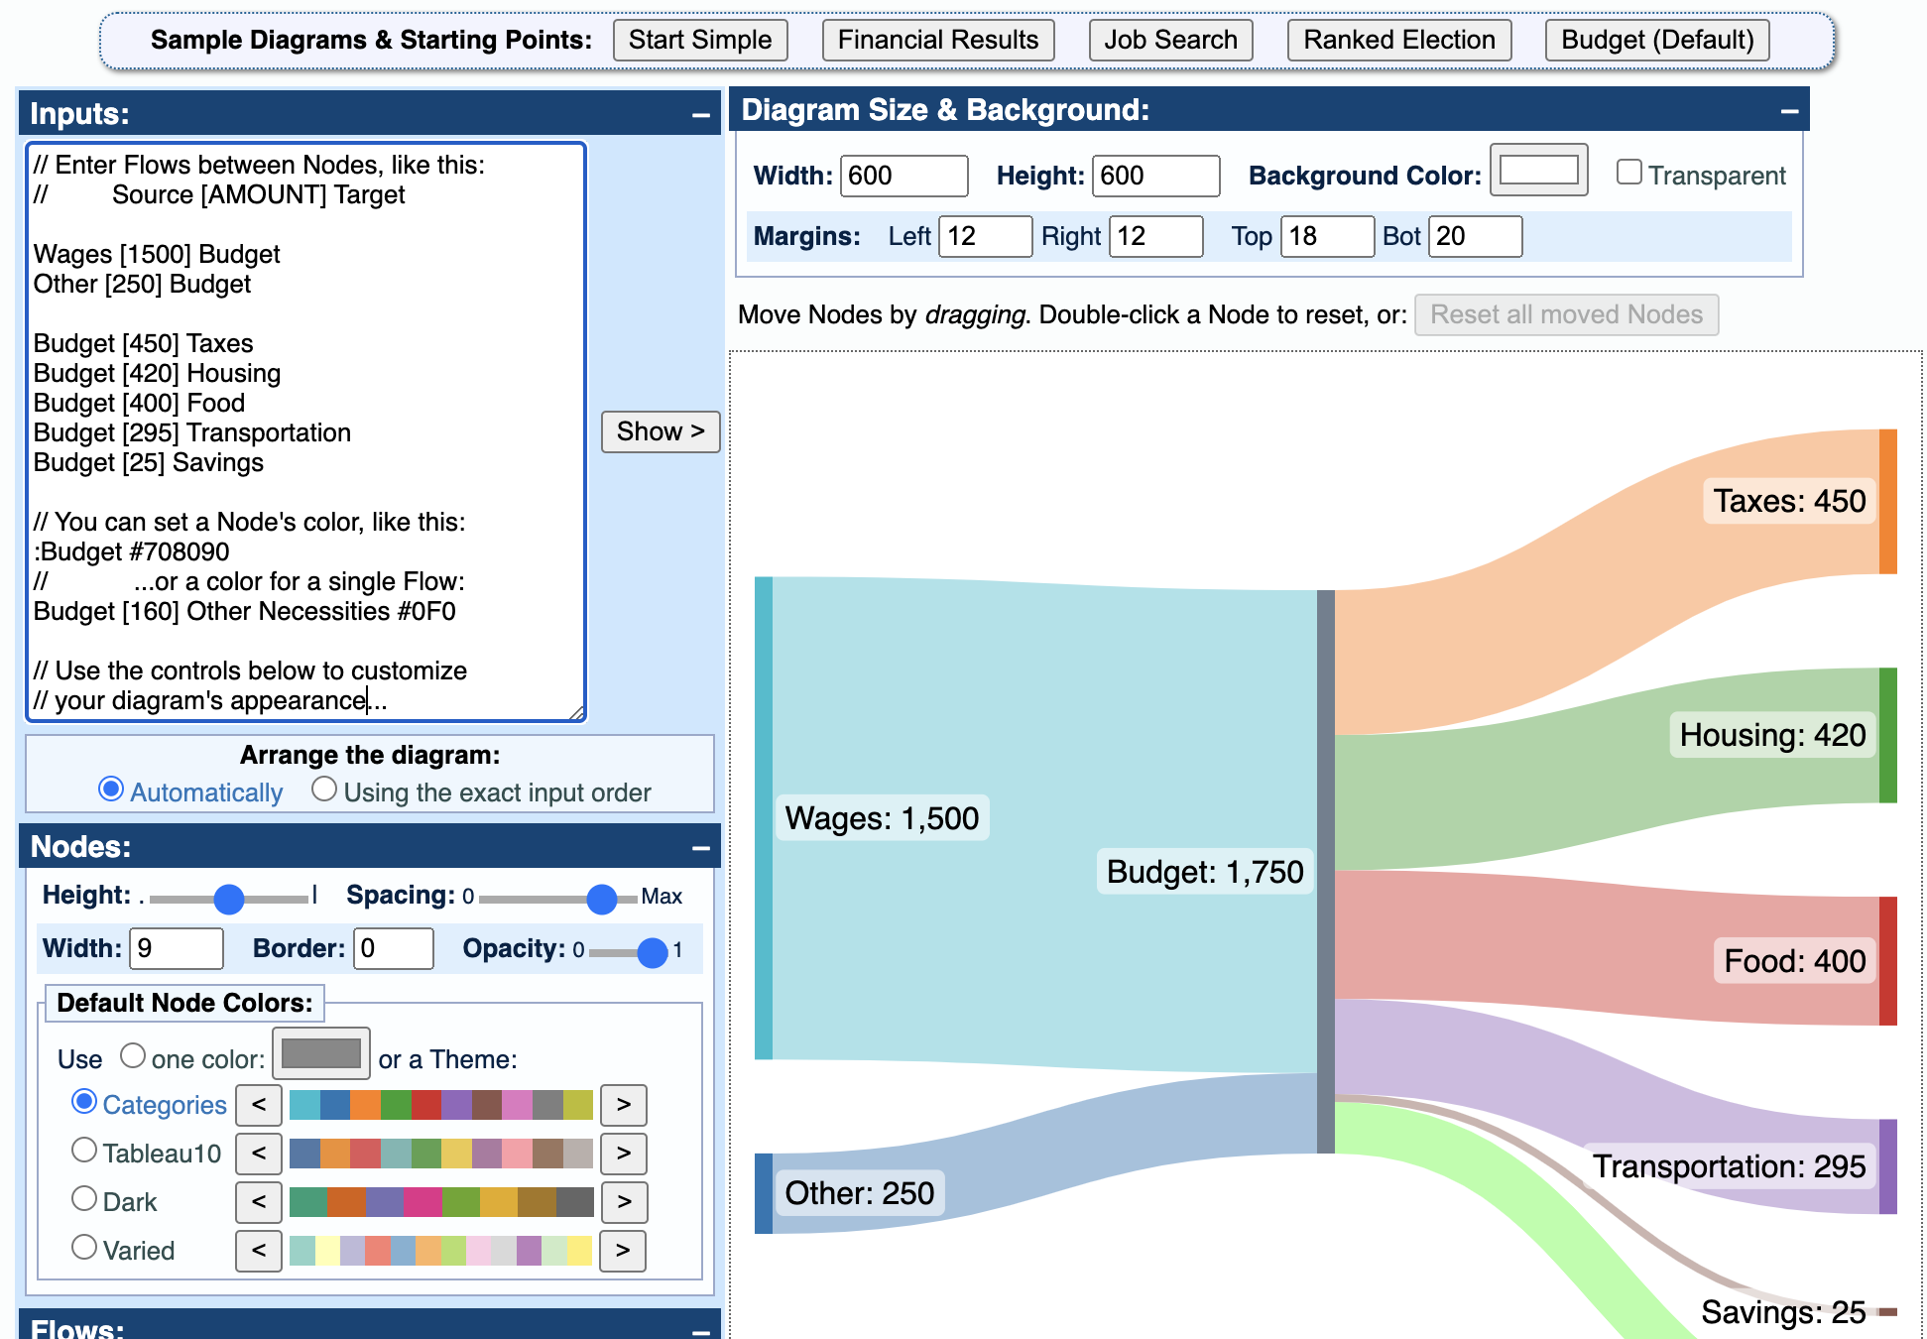
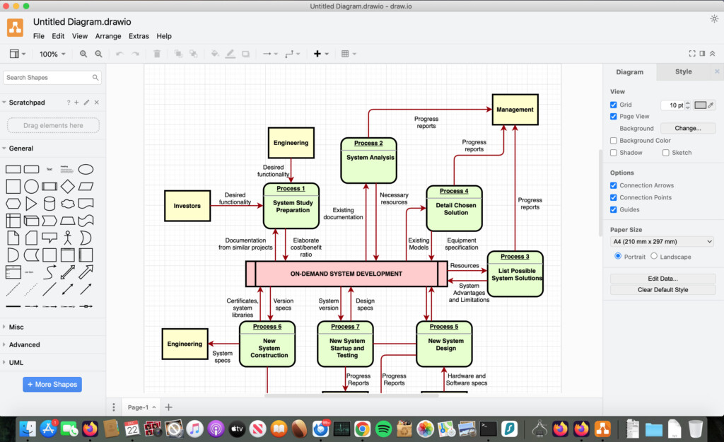
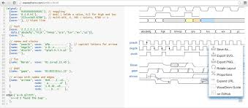
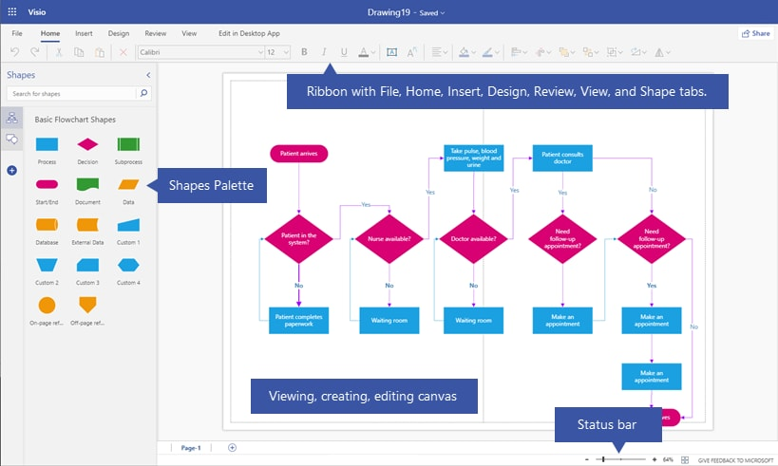
Draw.io – wavedrom – sankeymatic – MS Visio

Slide 7




Major Electronic Design Automation (EDA) vendors

Slide 8

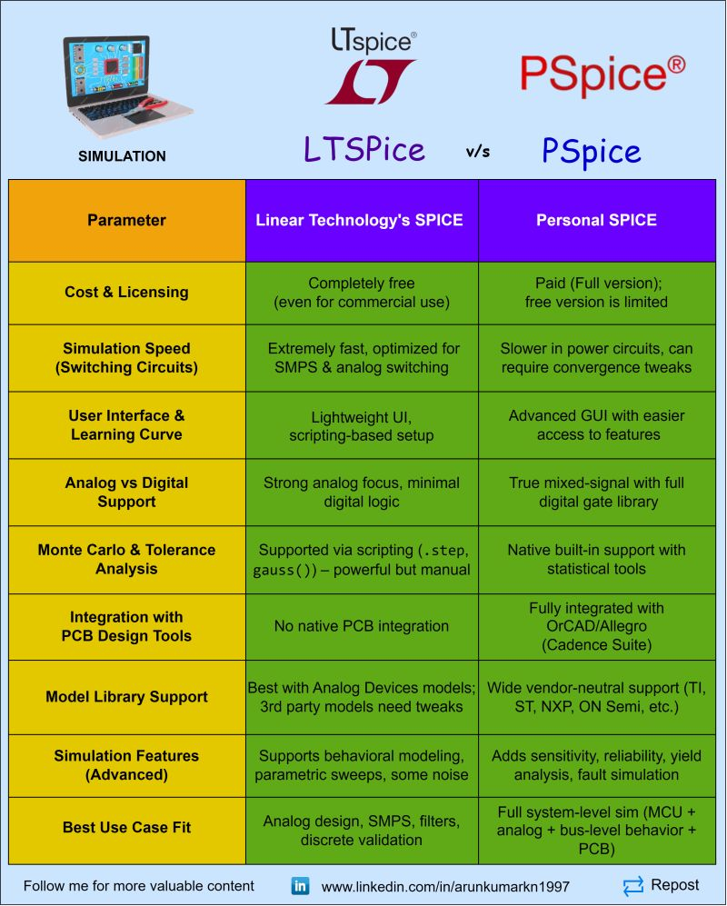
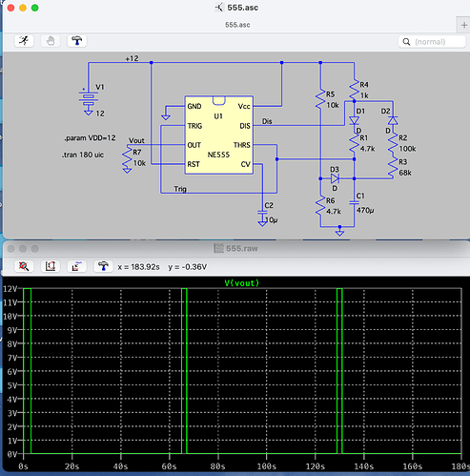

SPICE simulation

Slide 9


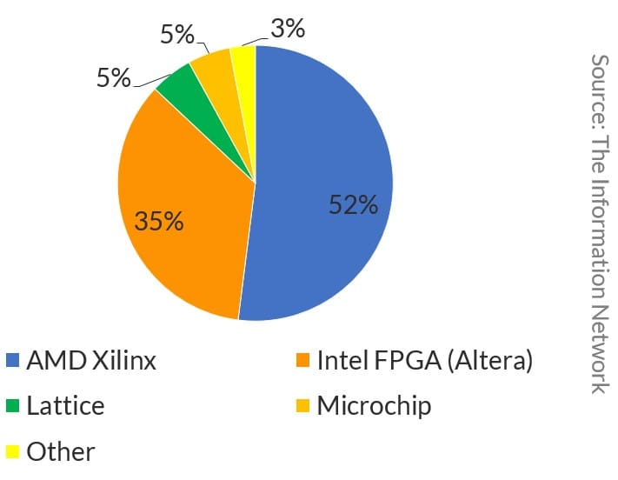


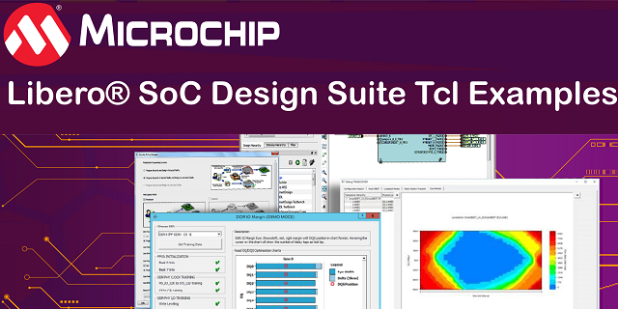
FPGA design suite

Slide 10
PCB design process
Gather requirements
Block diagram
Schematic Design
Simulation
Bill Of Materials
PCB Layout
(Simulation)
Manufacturing
Testing and validation

Slide 11
Gather requirements
Number of IO
Connector type
MAX bandwidth
Electromagnetic Interference (EMI) Electromagnetic Compatibility (EMC)
Sector regulations
Power and thermals
Size constraints
Parts availability
Time (development, production, validation)
Budget
Features

Slide 12
Course goal (Gather requirements)
Develop a custom module with:
8 analog inputs connected to a 12 bit 1 Msps ADC (sma 90° PCB mount connectors)
500 KHz -3 dB FEE bandwidth
Programmable gain/attenuation (-10 dB, 0 dB, +10 dB)
10 GPIO digital pins
1 analog out, buffered (0-3.3 V) – 1 MHz bandwidth – 12 bit resolution
FPGA data processing

Slide 13
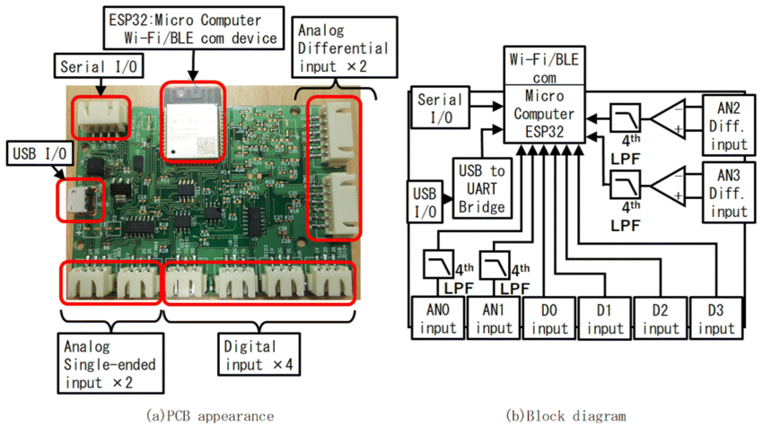
Block diagram

Slide 14
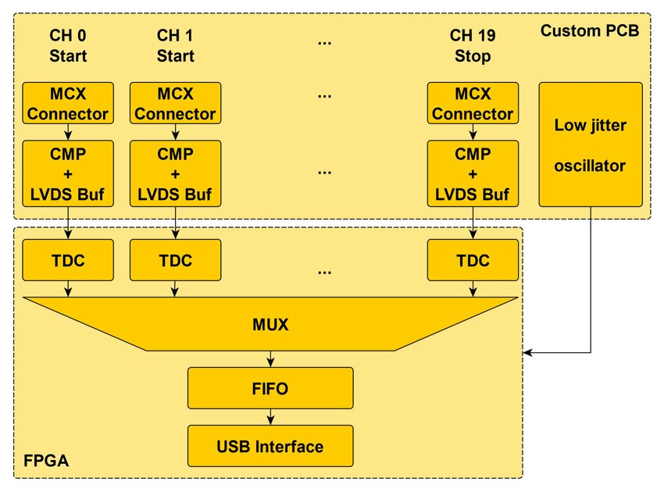
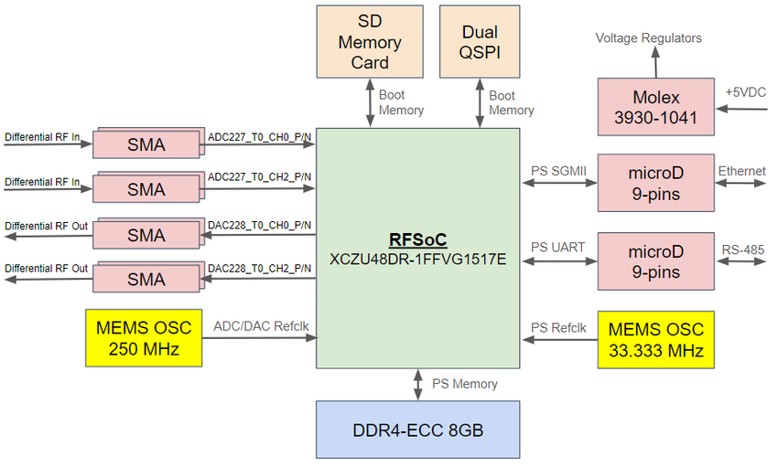

Slide 15
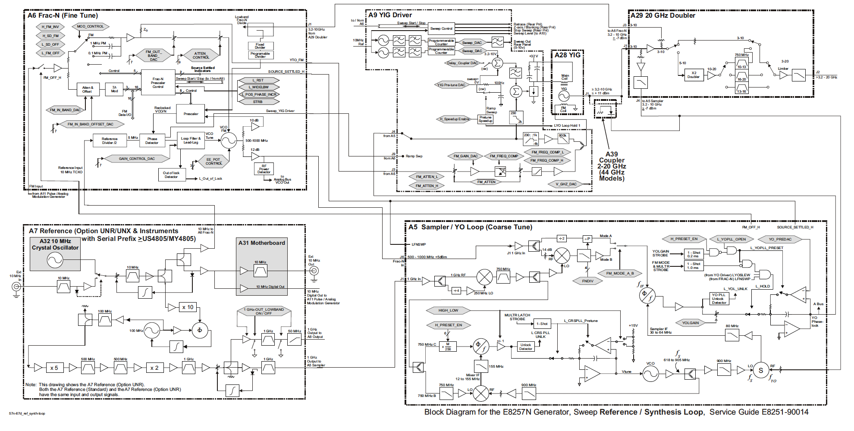

Agilent E8257D block diagram example

Slide 16
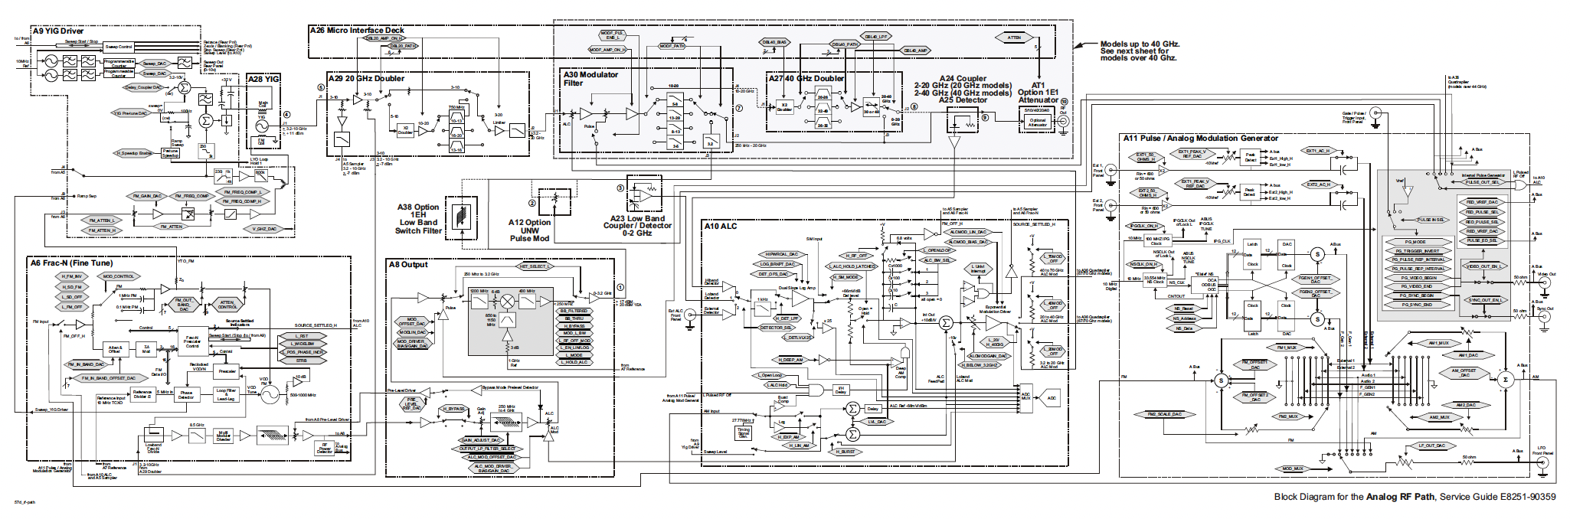
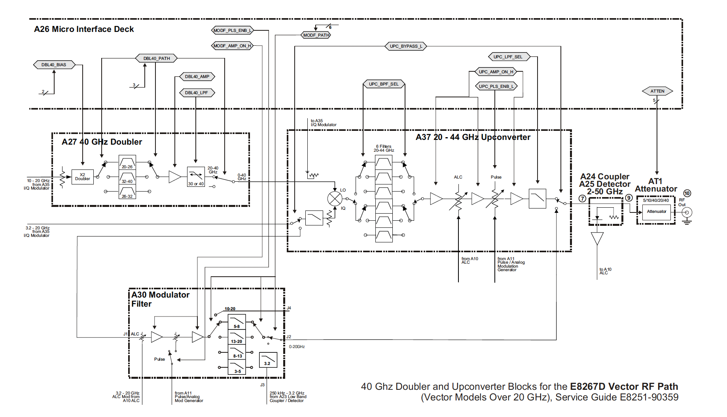
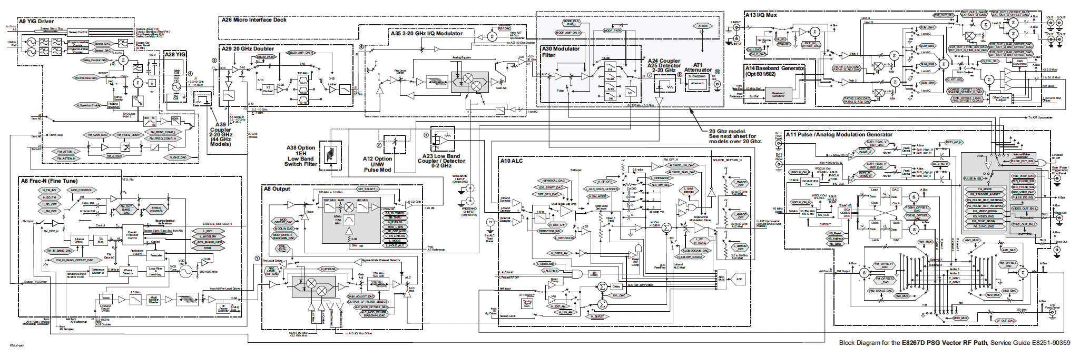
Agilent E8257D block diagram example

Slide 17
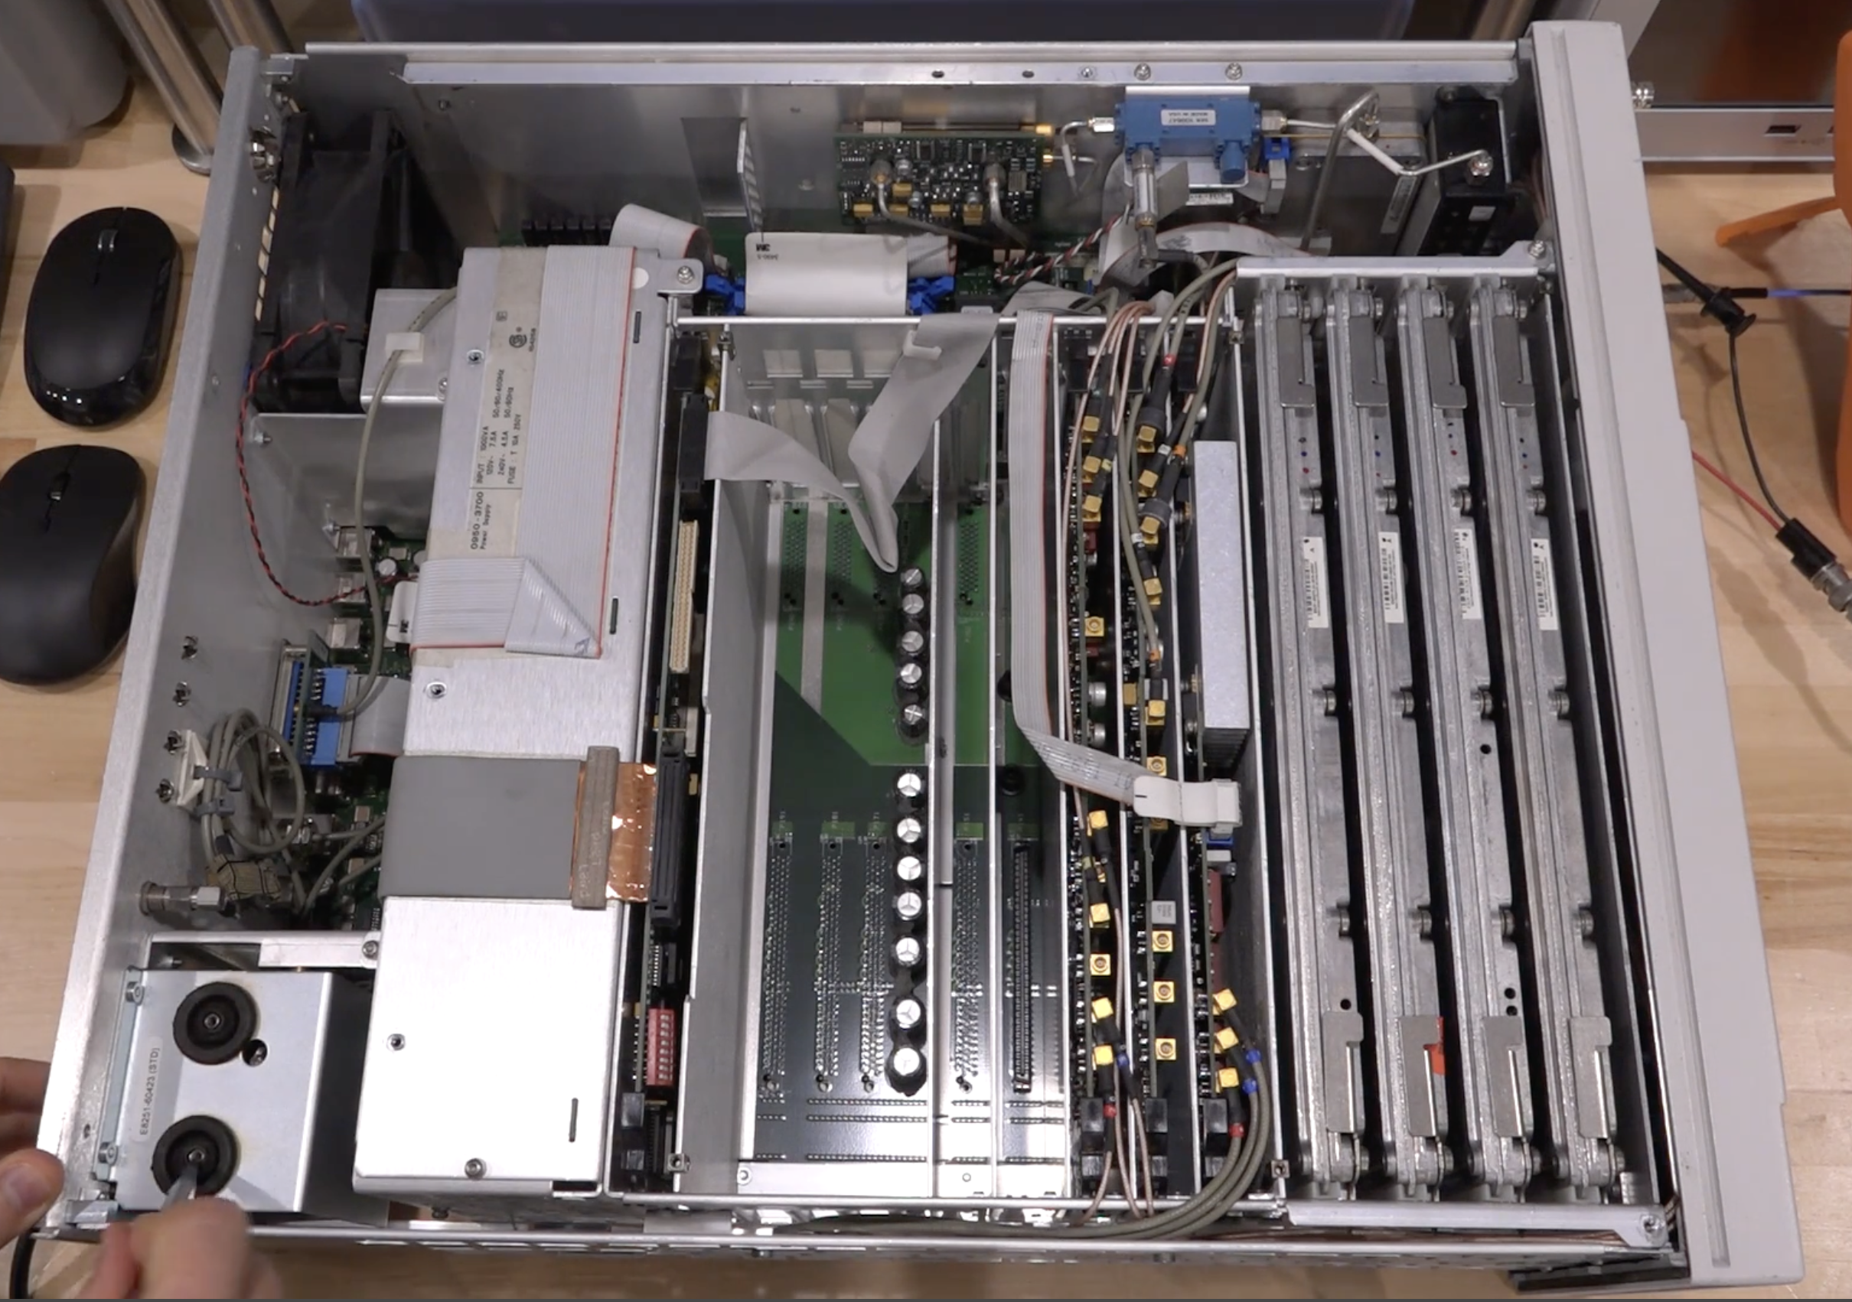
Agilent E8257D

Slide 18
Hands-on session 0 – Git
“A distributed system to track changes in source code, enabling multiple people to work together on non-linear development.”
Setup & Basics | Branch & Merge | Investigate & Fix
git init - Start repo | git branch - List branches | git log - View history
git clone <url> - Copy repo | git checkout <branch> - Switch | git status - Check changes
git add . - Stage all | git merge <branch> - Combine | git diff - See differences
git commit -m "msg" - Save | git branch -d <name> - Delete | git restore <file> - Undo changes
git push - Upload |  | git stash - Temporarily save
git pull - Download

Slide 19
Hands-on session 1 – Draw.IO

Slide 20
A bit of nomenclature

Slide 21
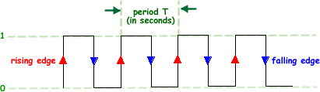
Clock
A clock is a periodic timing signal used to synchronize operations in an electronic system, defining when data is sampled, transferred, or processed.
62.5 ns (16 MHz): Arduino UNO
20.8 ns (48 MHz): USB full-speed devices and many microcontrollers
10 ns (100 MHz): Common system clock for digital logic and CPUs
1 ns (1 GHz): High-speed processors and modern communication systems

Slide 22
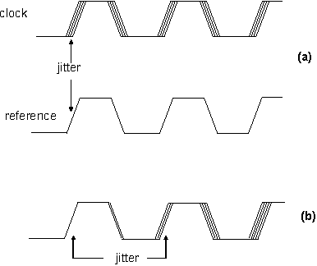
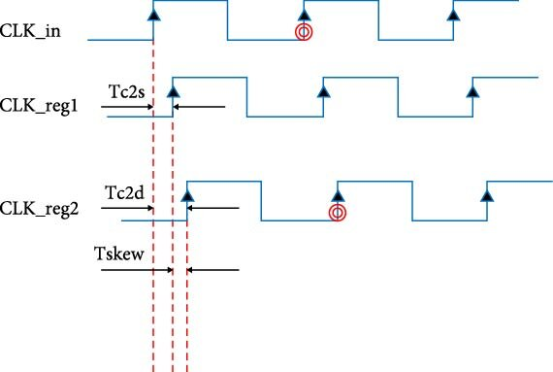
Skew and Jitter
Skew is the fixed or slowly varying difference in timing between related signals (for example, two clock or data lines) that are intended to arrive simultaneously but do not due to path length, component, or loading differences.
Jitter is the short-term, random or deterministic variation in the timing of a signal’s edges from their ideal positions, typically caused by noise, interference, or instability in the clock source.

Slide 23
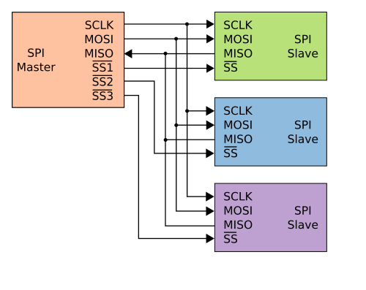
SPI (Serial Peripheral Interface)
SPI is a synchronous serial communication protocol used for short-distance communication between a master and one or more slave devices. It uses separate lines for data in, data out, clock, and chip select, enabling high data rates and simple hardware. Communication is full-duplex.

Slide 24
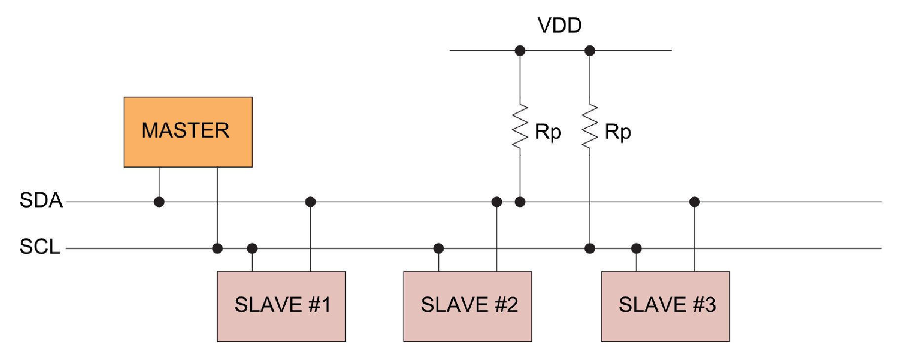
I2C (Inter-Integrated Circuit)
I2C is a synchronous, multi-master serial bus that uses only two lines: a data line and a clock line. Devices are addressed, allowing many peripherals to share the same bus. It is widely used for low-speed communication with sensors, EEPROMs, and configuration devices.

Slide 25
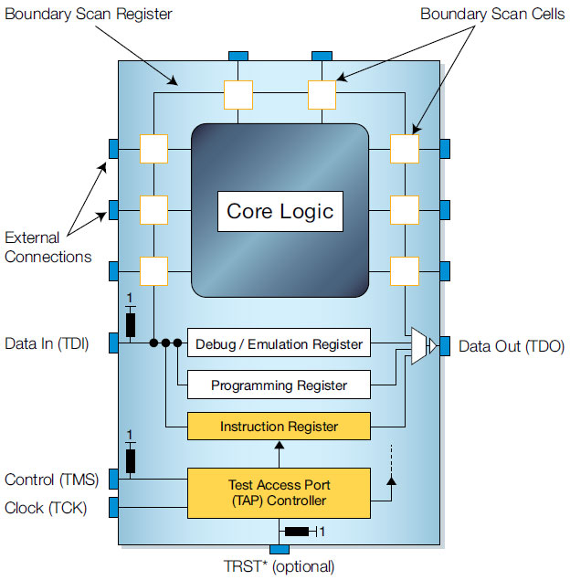
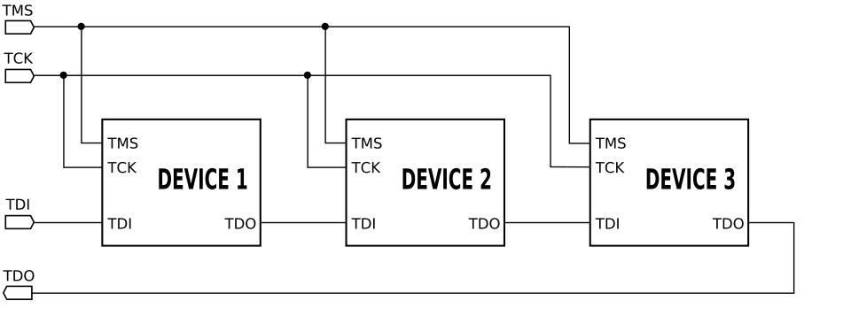
JTAG (Joint Test Action Group)
JTAG is a standard interface used for testing, debugging, and programming electronic devices. It provides access to internal registers and logic through a small set of dedicated pins. JTAG is commonly used for boundary-scan testing and in-system debugging of microcontrollers and FPGAs.

Slide 26
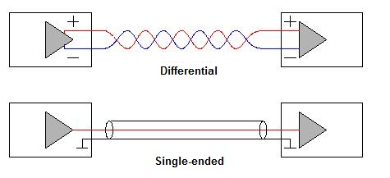
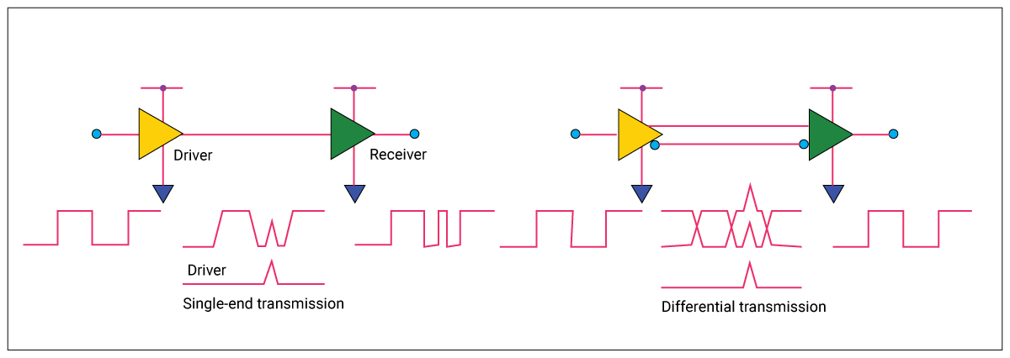
Single ended & Differential signaling
Single-ended signaling transmits information using one signal line referenced to a common ground. It is simple and low-cost but more susceptible to noise, ground offsets, and electromagnetic interference, especially at high speeds or long distances.
Differential signaling uses two complementary signal lines, and information is conveyed by the voltage difference between them.

Slide 27
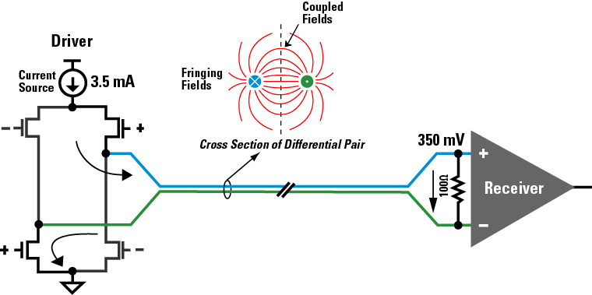
LVDS (Low-voltage differential signaling)

Slide 28
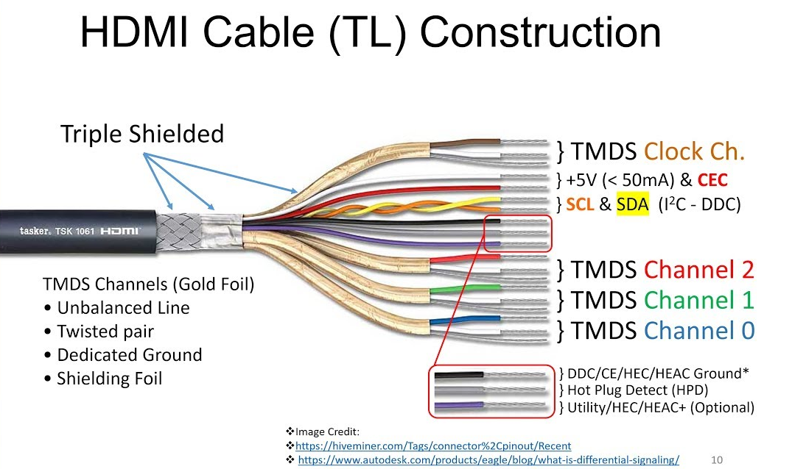
TMDS (Transition-minimized differential signaling)

Slide 29
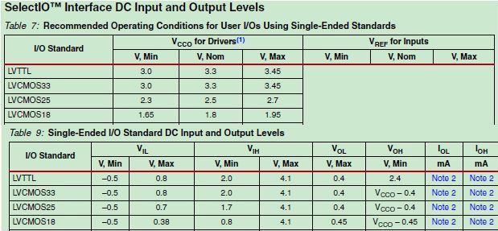
Signaling standards

Slide 30
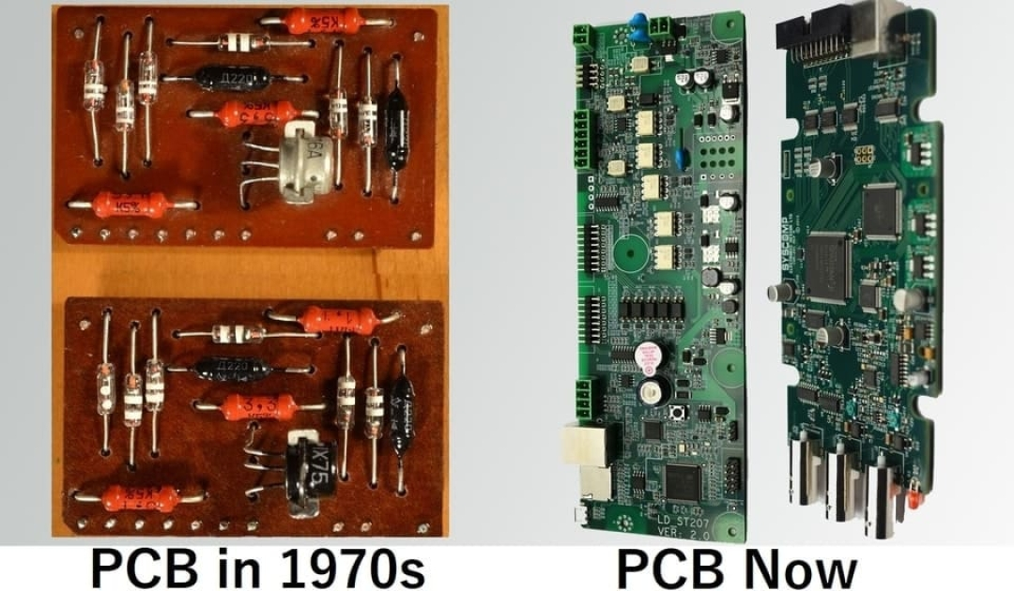
PCB development and history

Slide 31
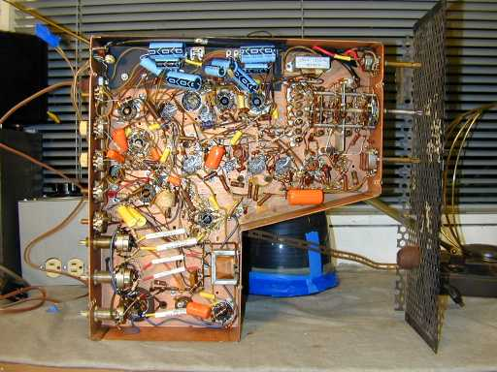
Why we need Printed Circuit Boards
Miniaturize devices
Improve mass production
Reduce cost
Improve yeld
Increase repeatability
Reduced parasitics
An old Motorola television without PCB from 1948

Slide 32
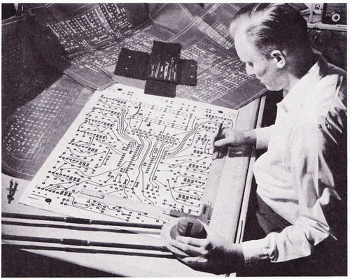
Drawing a PCB with tape and mylar before EDA arrived

Slide 33
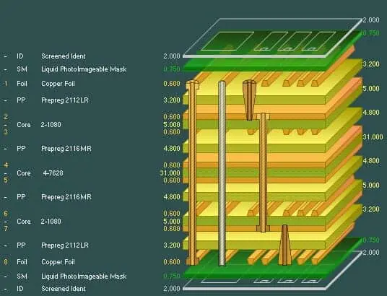
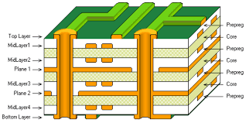
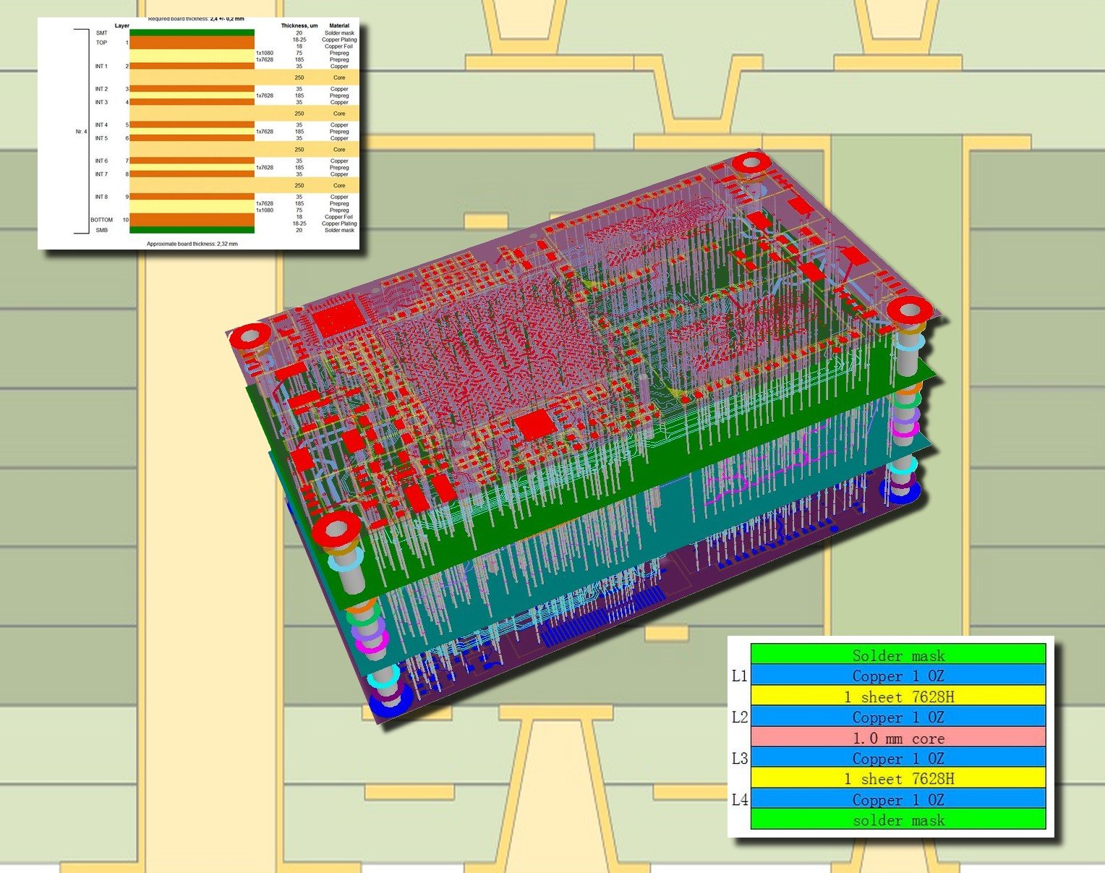
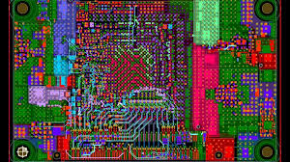
PCB stackup/1

Slide 34
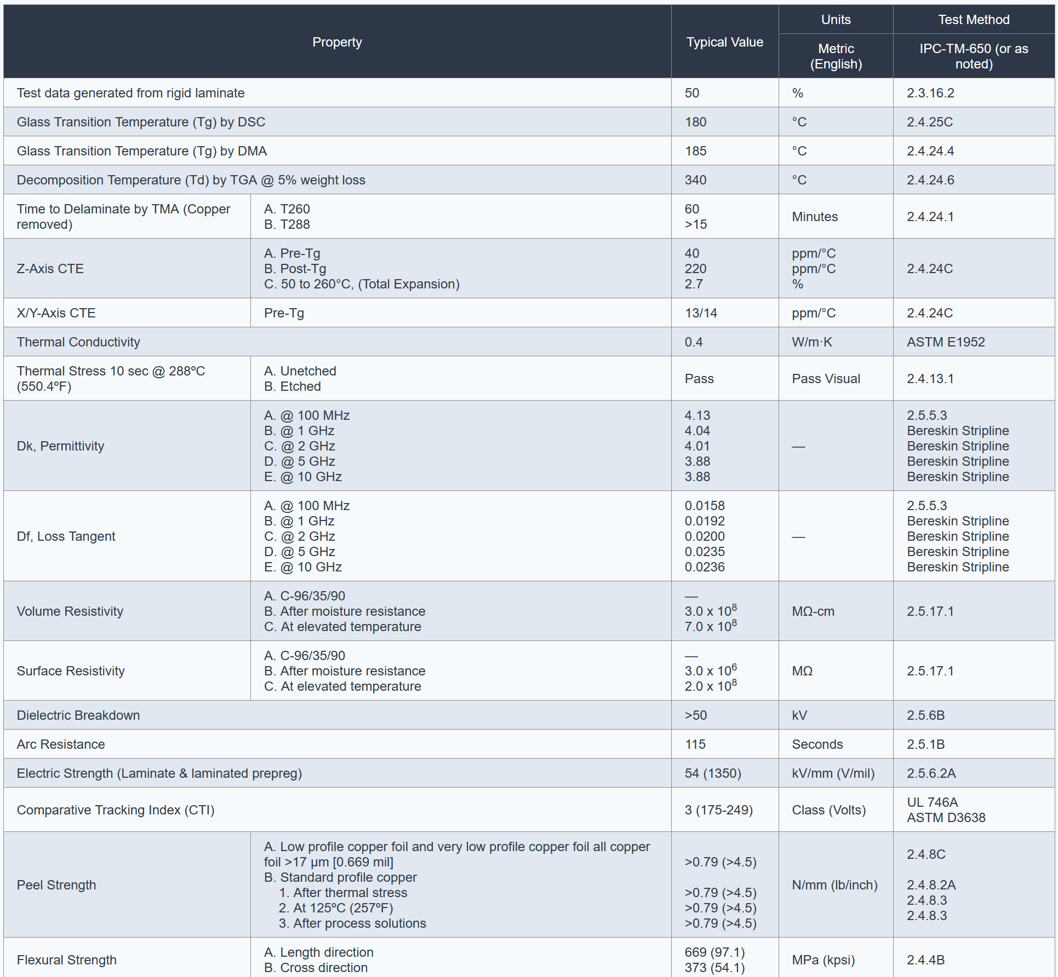


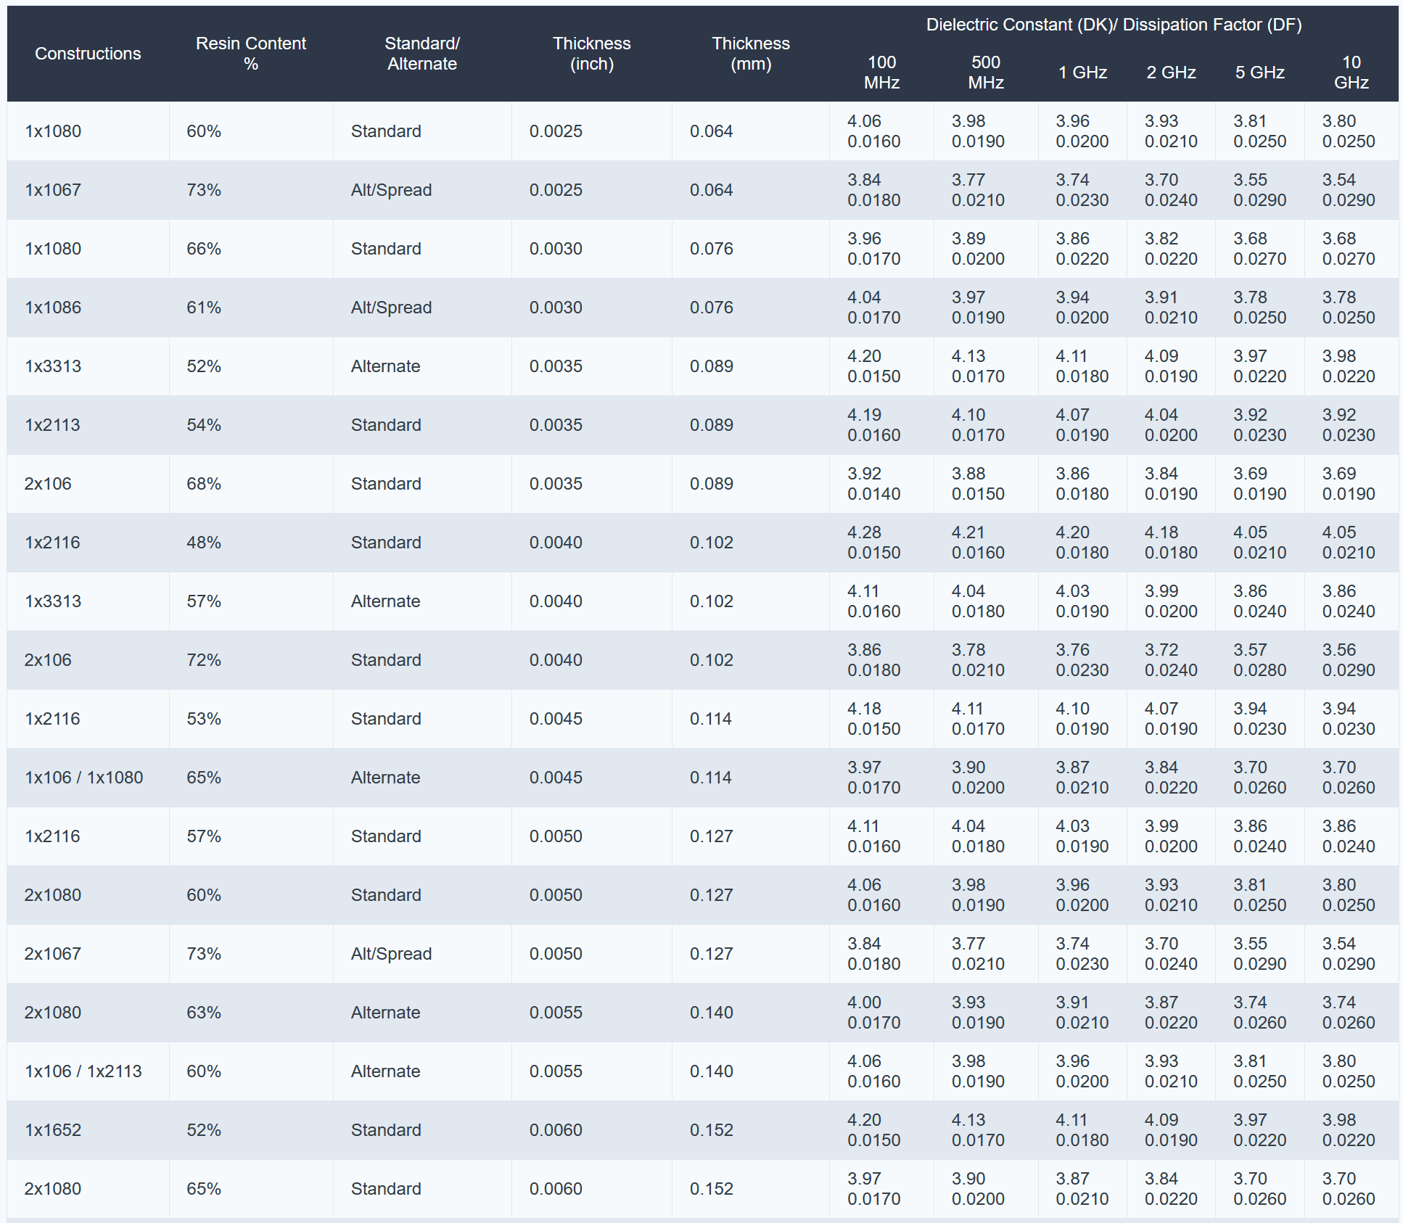
PCB stackup/2

Slide 35
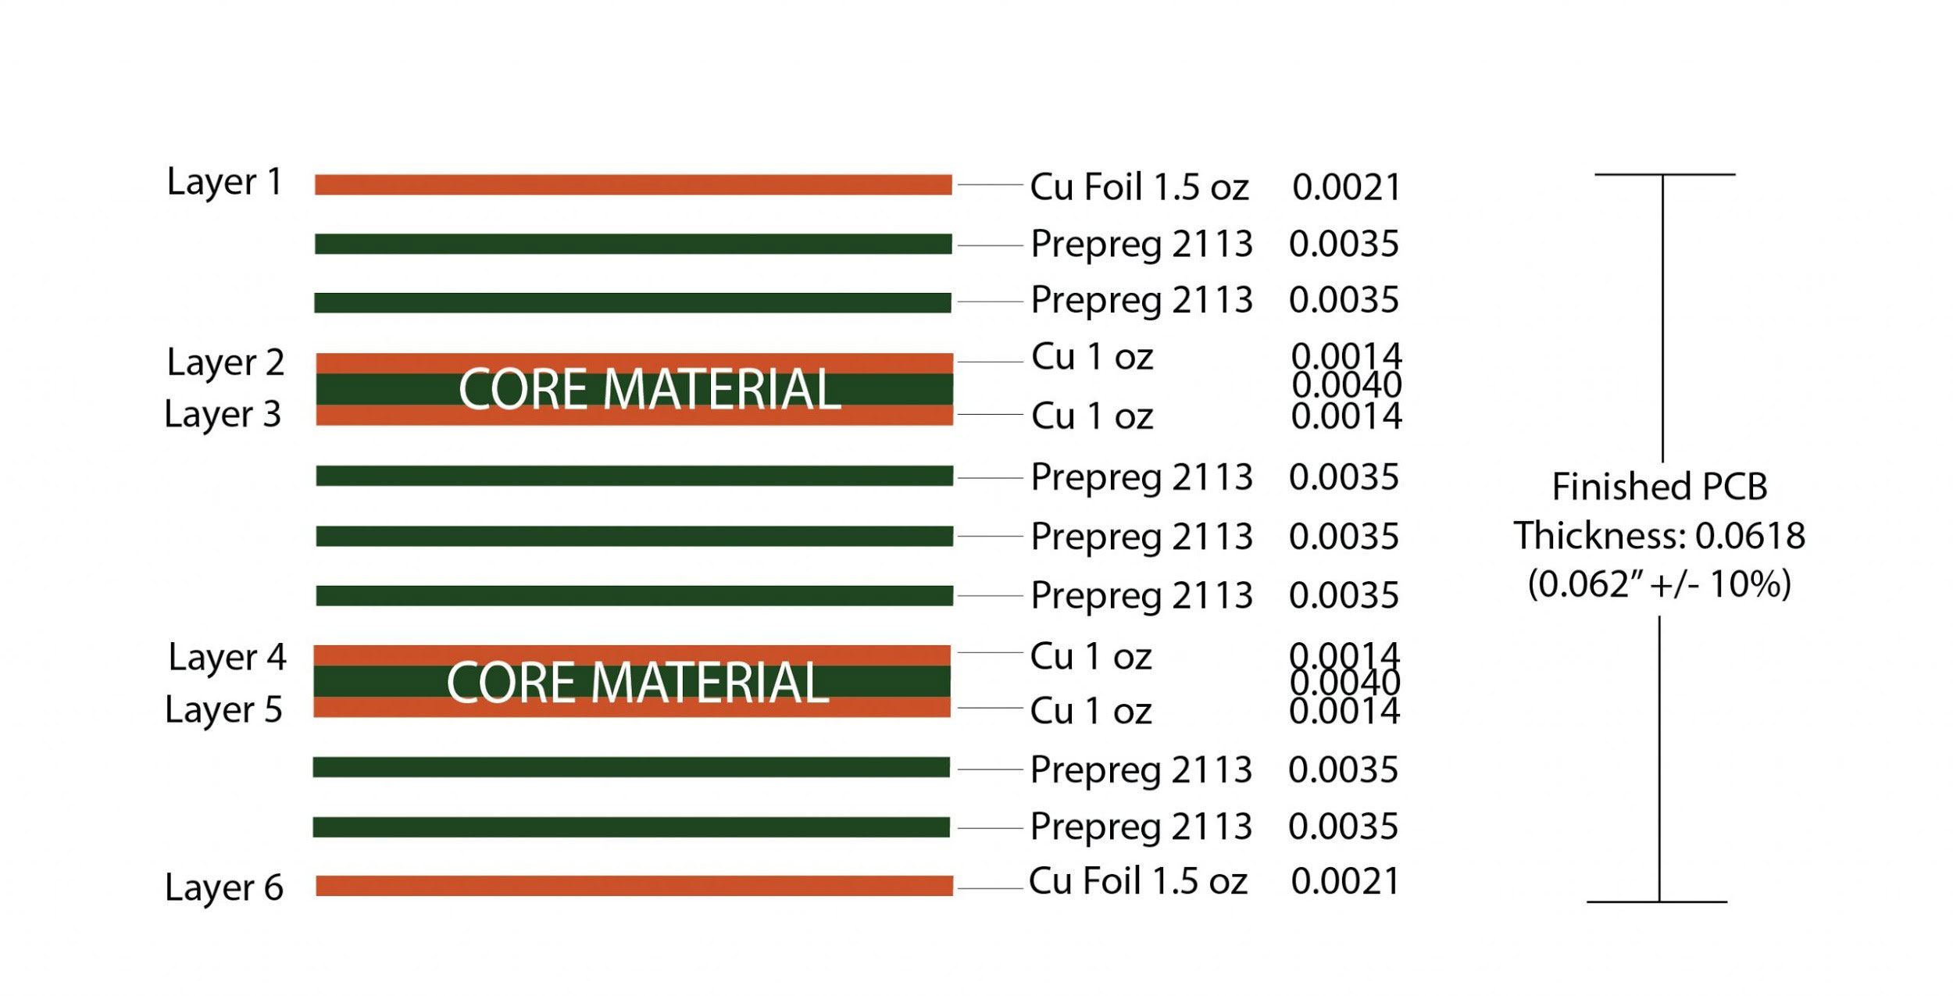
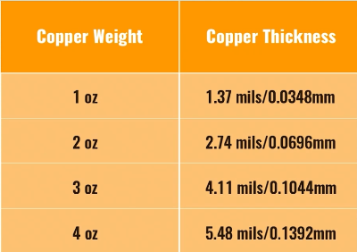
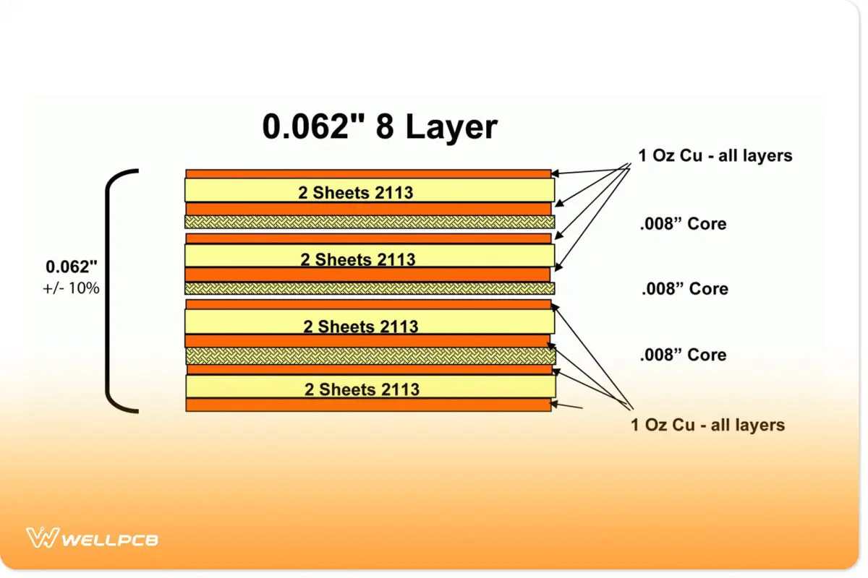
Nominal dimensions

Slide 36
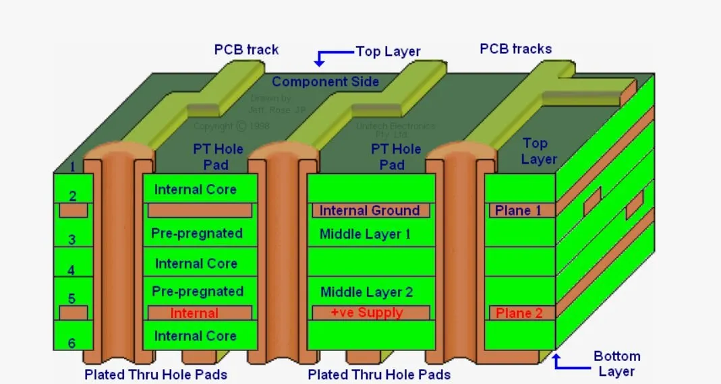
Some nomenclature

Slide 37
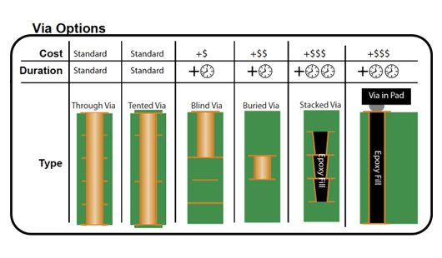



VIAs

Slide 38

Tracks

Slide 39
Components

Slide 40




Fiducial and tooling holes

Slide 41

PCB parasitics/1

Slide 42


PCB parasitics/2

Slide 43



Distributed-element filter
A microstrip low pass filter implemented with bowtie stubs inside a 20 GHz Agilent N9344C spectrum analyser
Stepped-impedance low-pass filter formed from alternate high and low impedance sections of line
A microstrip hairpin filter followed by a low pass stub filter on a PCB in a 20GHz Agilent N9344C spectrum analyser

Slide 44

Schematic Design in KiCAD

Slide 45



Symbol – Footprint and 3D model

Slide 46
Common schematic mistakes
Missing or insufficient decoupling capacitors
Incorrect reset circuit design
Floating inputs and unused pins
Power rails not properly filtered
Missing pull-up / pull-down resistors
No consideration of startup sequencing

Slide 47
Simulation

Slide 48
Bill Of Materials

Slide 49
PCB Layout

Slide 50
(Simulation)

Slide 51
Manufacturing

Slide 52
Testing and validation

Slide 53
Hands-on session 2 - KiCAD

Slide 54


Slide 55
Common Power Supply Issues
Undersized voltage regulators
No bulk capacitors on power rails
Long power traces causing voltage drops
Sharing analog and digital supplies incorrectly
No ferrite beads or filtering where required

Slide 56
Common PCB Layout Mistakes
Poor component placement
Long clock or reset traces
No continuous ground plane
Splitting ground planes under high-speed signals
Decoupling capacitors placed too far from IC pins
Routing signals without considering return paths

Slide 57
Typical First-Power-On Failures
Wrong component orientation
Incorrect footprint
Missing power rail
Short circuits due to layout errors
Incorrect connector pinout

Slide 58
Common FPGA Design Mistakes
Using asynchronous logic unintentionally
Mixing blocking and non-blocking assignments incorrectly
Missing reset conditions
Multiple clock domains without synchronization
Ignoring timing constraints

Slide 59
Simulation vs Hardware Reality
Simulation works but hardware does not
Missing timing constraints
Uninitialized signals
Clock frequency assumptions wrong
Metastability not considered

Slide 60
Design for testabilty
Always start from power and clock
Verify reset behavior
Reduce the design to a minimal working configuration
Trust measurements, not assumptions
Change one thing at a time

